Slide 1
NBC plastic litter incubations

Slide 2
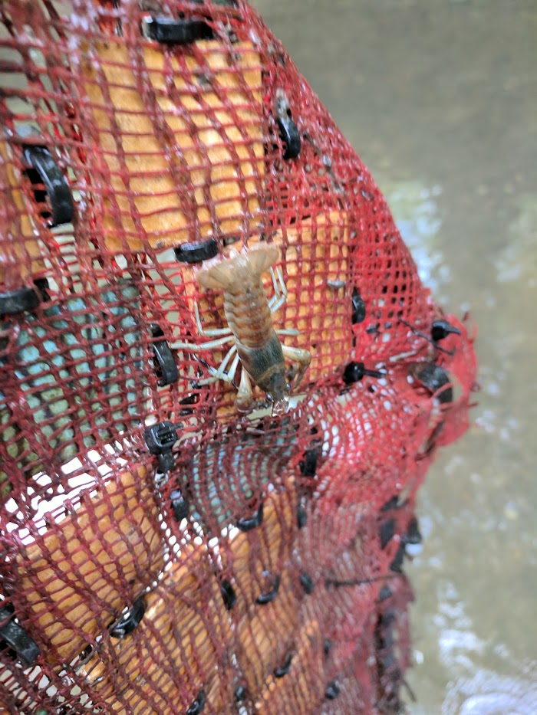
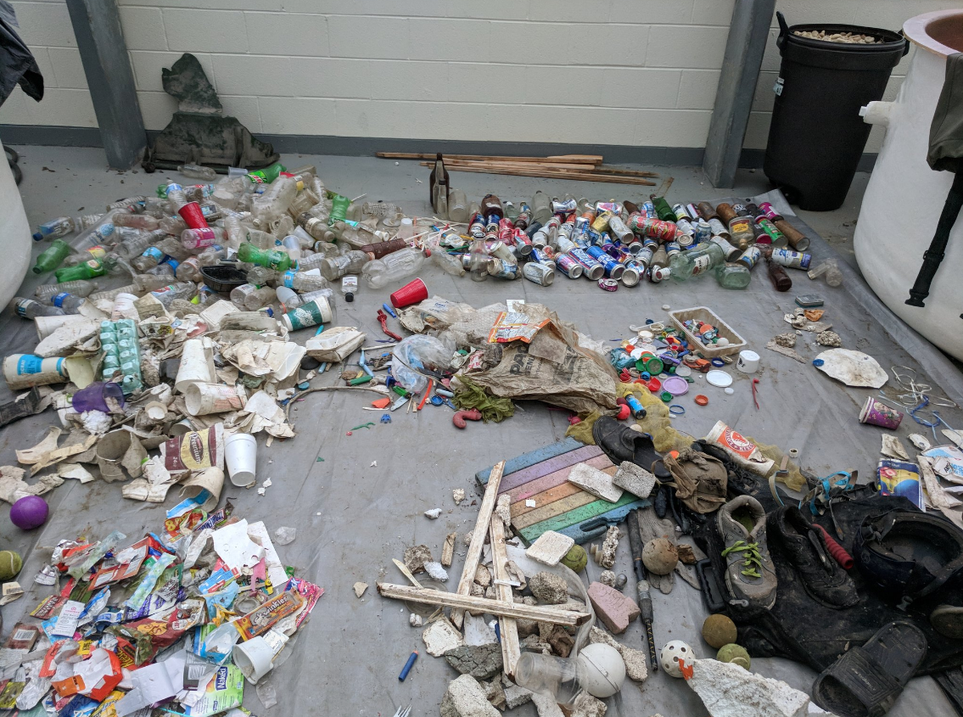
Rationale
Plastics are an increasingly frequent within rivers and streams
Their persistent nature makes them a novel substrate for riverine biology
Will this increasingly frequent surface have an impact on the overall ecosystem function of a river?
Photo Credit: Lisa ‘s Twitter

Slide 3
Question
Do plastic AL morphotypes affect microbial colonization, succession, and function?
Or “are all plastics equally effective substrates for biofilms in the NBC?”

Slide 4
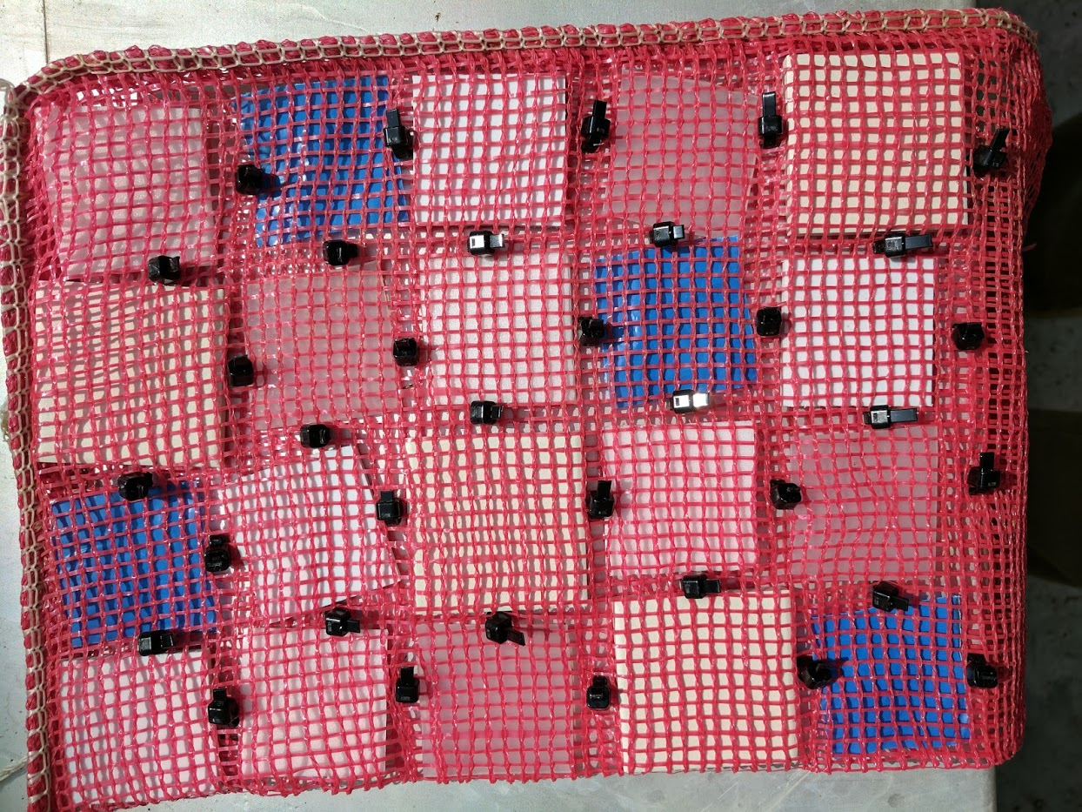
Approach
Sheet PE
Polystyrene Foam (PS)
Soft PE
We incubated four types of plastic and a natural analogue for ~5 weeks and quantified the development and activity of biofilms on those materials
Destructive sampling at 10 points over this time period provided a series of snapshots of what is occurring on the surface
PVC
Ceramic Tile

Slide 5
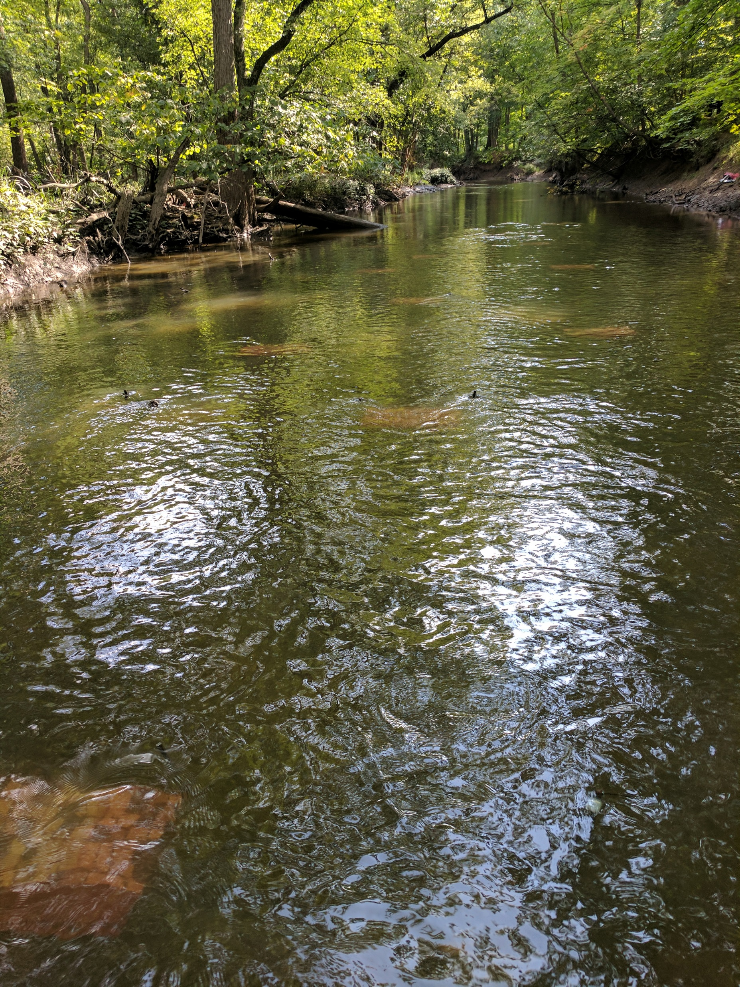
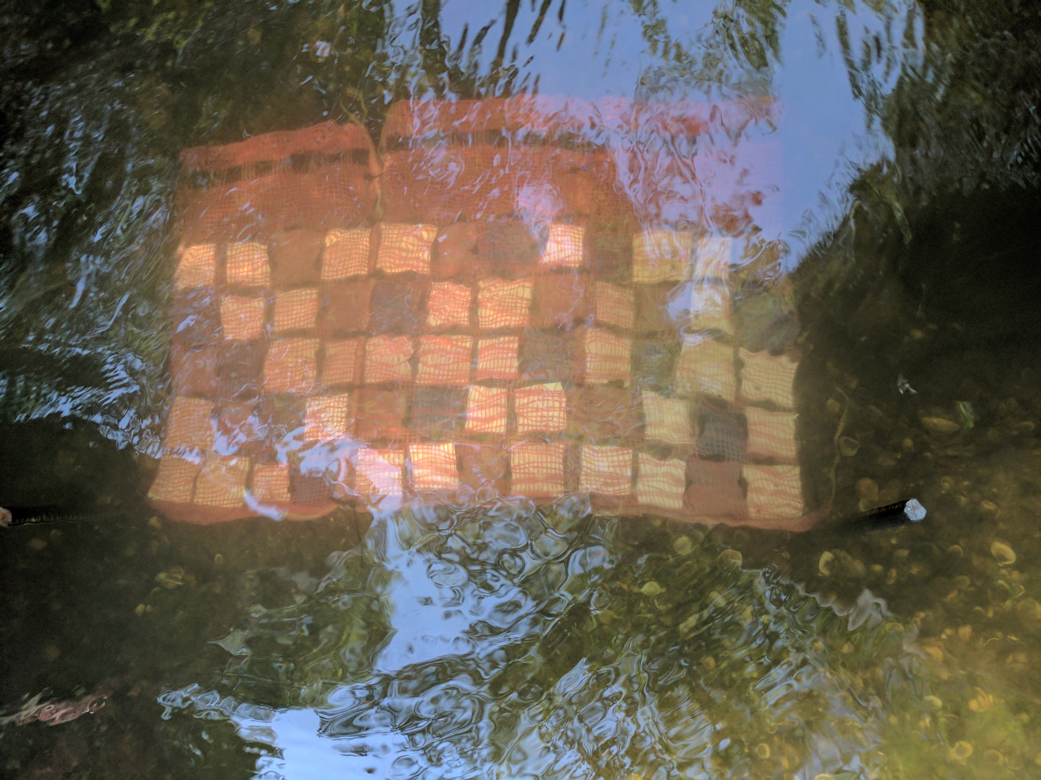
Field Design
Substrates were arranged randomly within litterbags to form “quilts”
Replicate bags were fastened to each other and attached to the benthos with rebar at random points within the thalweg of a 20m reach of the NBC at Harm’s Woods

Slide 6
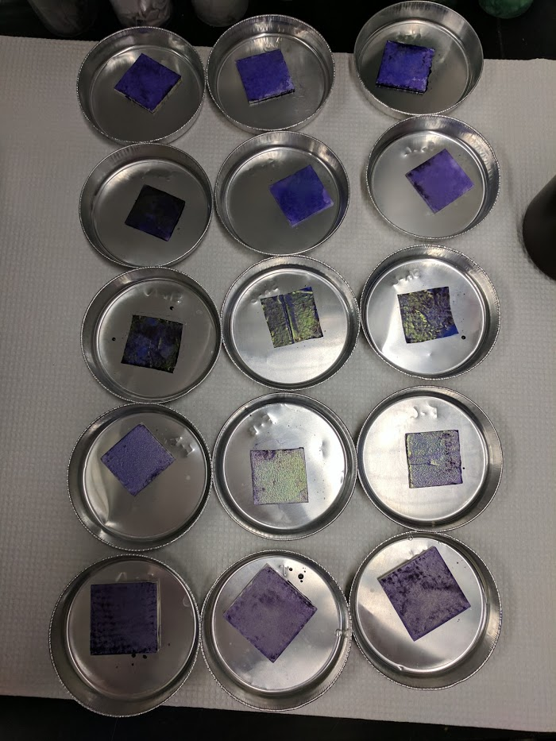
Laboratory Assays
Metabolism
GPP, Respiration, NEP
Extracellular Enzyme Activity
C,N,P processing enzyme potential
Crystal Violet
Biofilm size (analogous to biomass)
Chlorophyll
Biofilm Community
16s, 18s, 23s (pending)

Slide 7
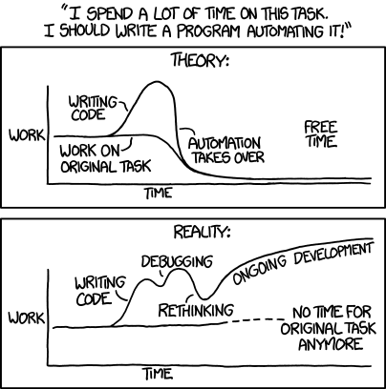
Analyses
We employed a linear mixed-effects model to determine if there were effects of Substrate type, Time, or an Interaction on the various assays we ran
Where a interaction existed, we then did ANOVA for each sampling date to look for effects of substrate
We combined all our data determined principal components with points grouped alternatively by Substrate and by Time
lme.gpp=anova(lme(GPP~Date.Sampled*Sample,random=list(id=pdBlocked(list(~1,pdIdent(~Sample-1),pdIdent(~Date.Sampled-1)))),method="ML",na.action=na.omit,data=metabolism.data))
GPP=response variable
Date Sampeld and Sample are predictive factors*
Random effects due to “resampling” over time. Each row in the data table is assigned an id value (1-15).
Output is the same as 2-way rmANOVA in SYSTAT!

Slide 8
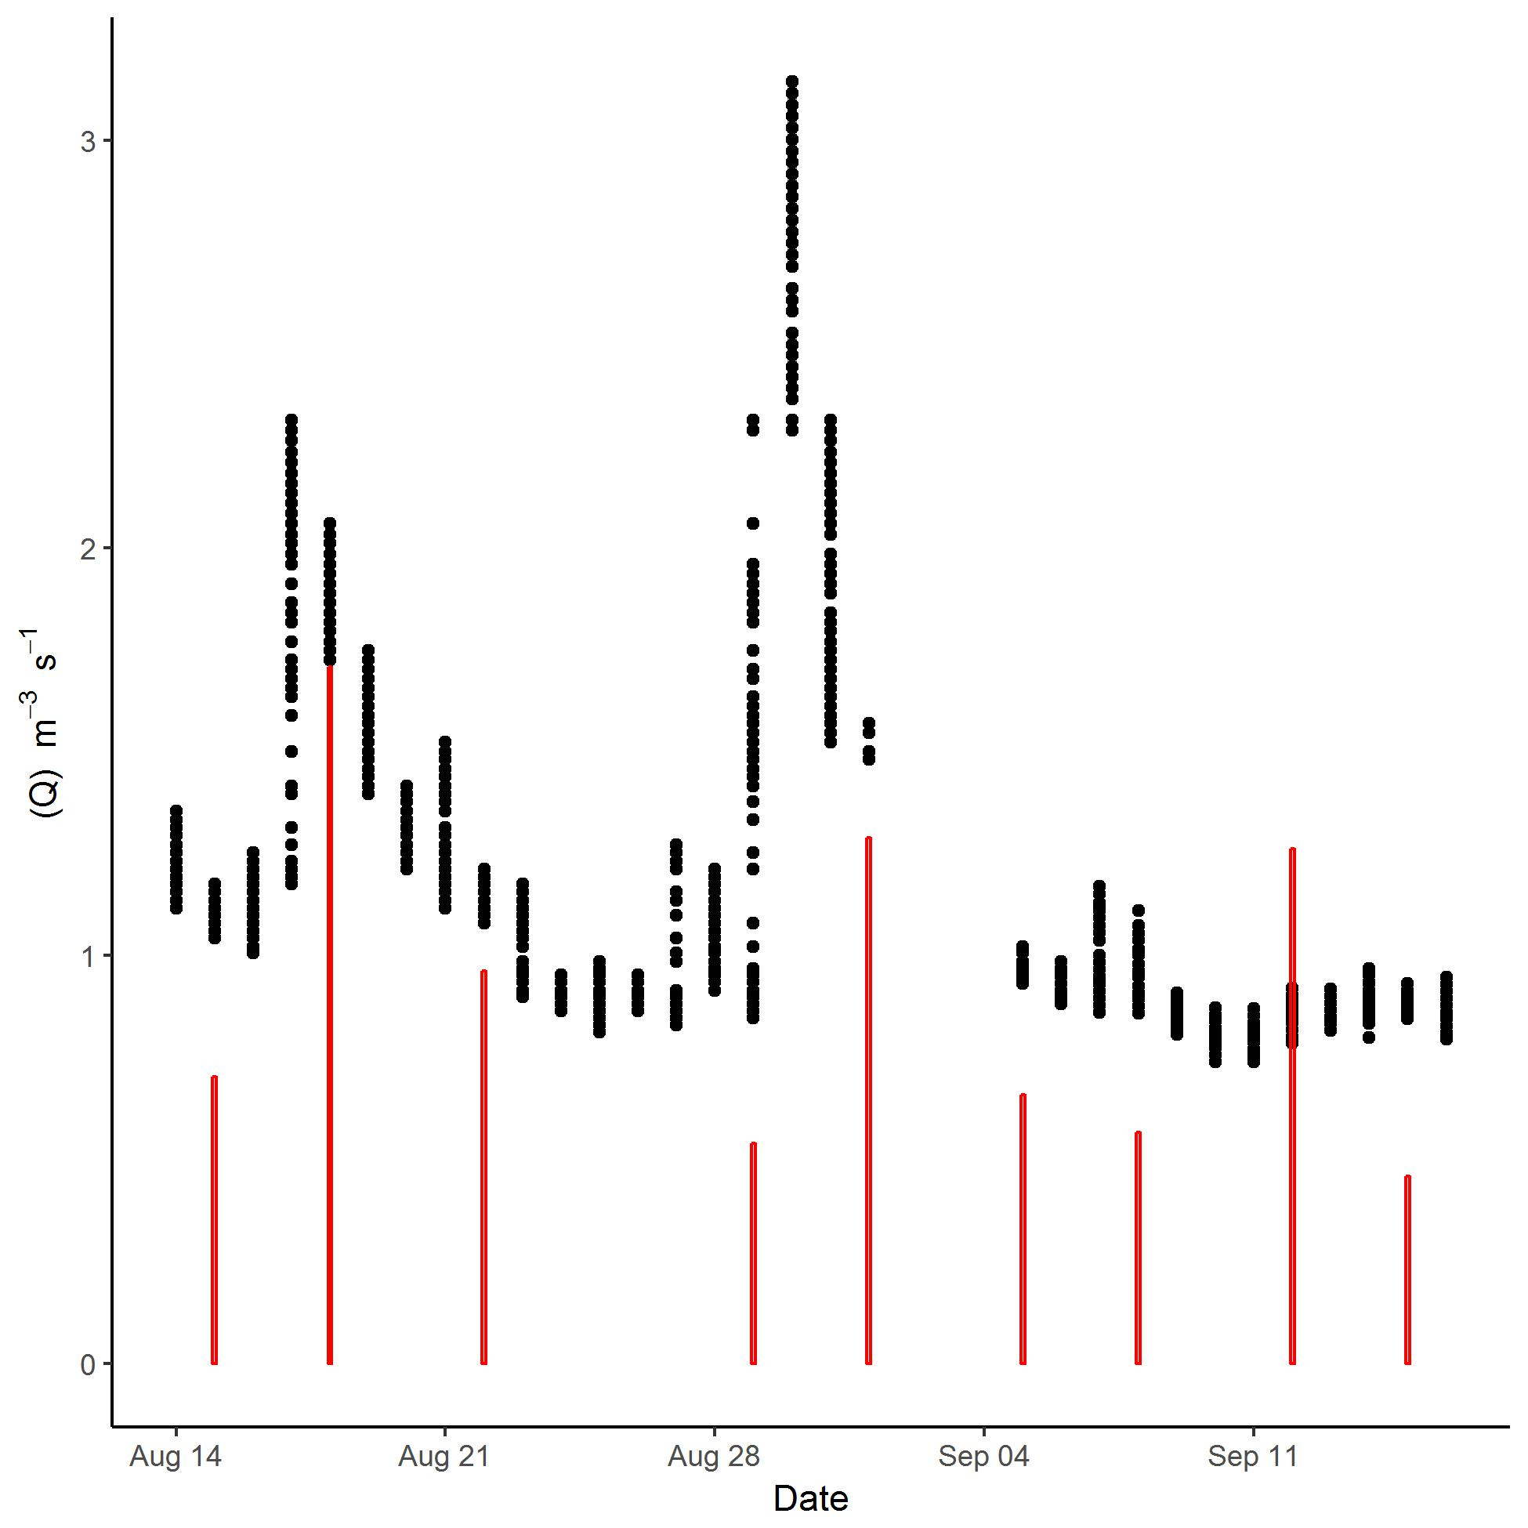
Black points are USGS gauge at Niles (3.44mi downstream)
Red bars are field observations of discharge at site

Slide 9
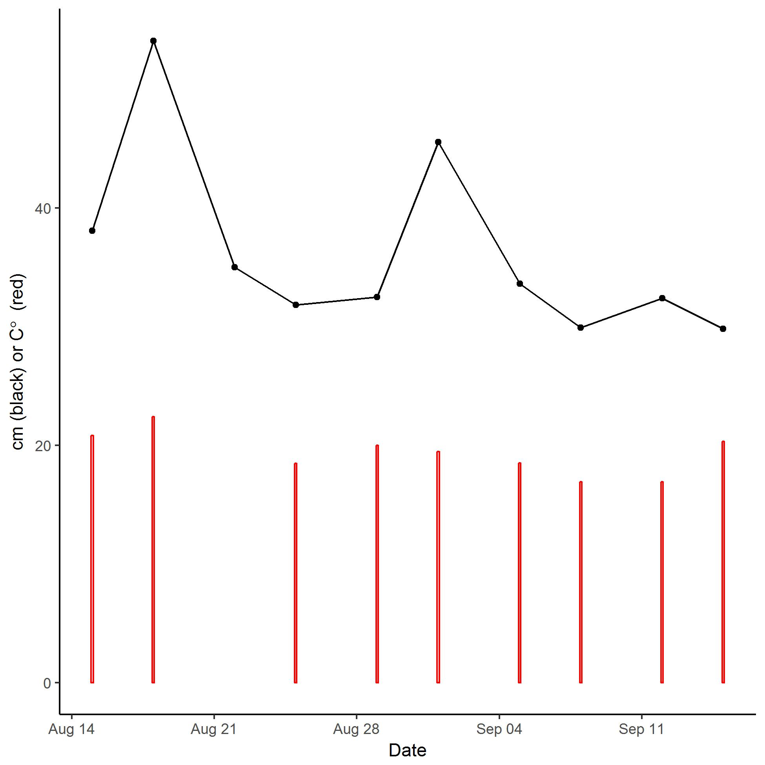
Depth (black) and temperature (red)
Depth follows discharge pattern from previous slide nicely.
No substantial patterns in other field data.

Slide 10
Table 1. F statistics and p-values from linear mixed effects models. There were significant interactions between substrate and time only for gross metabolic assays and C processing enzyme potential, but not for other specific enzymatic and biofilm development assays. For all assays, time was a significant factor. There was a significant effect of substrate within crystal violet, but no interaction.

Slide 11
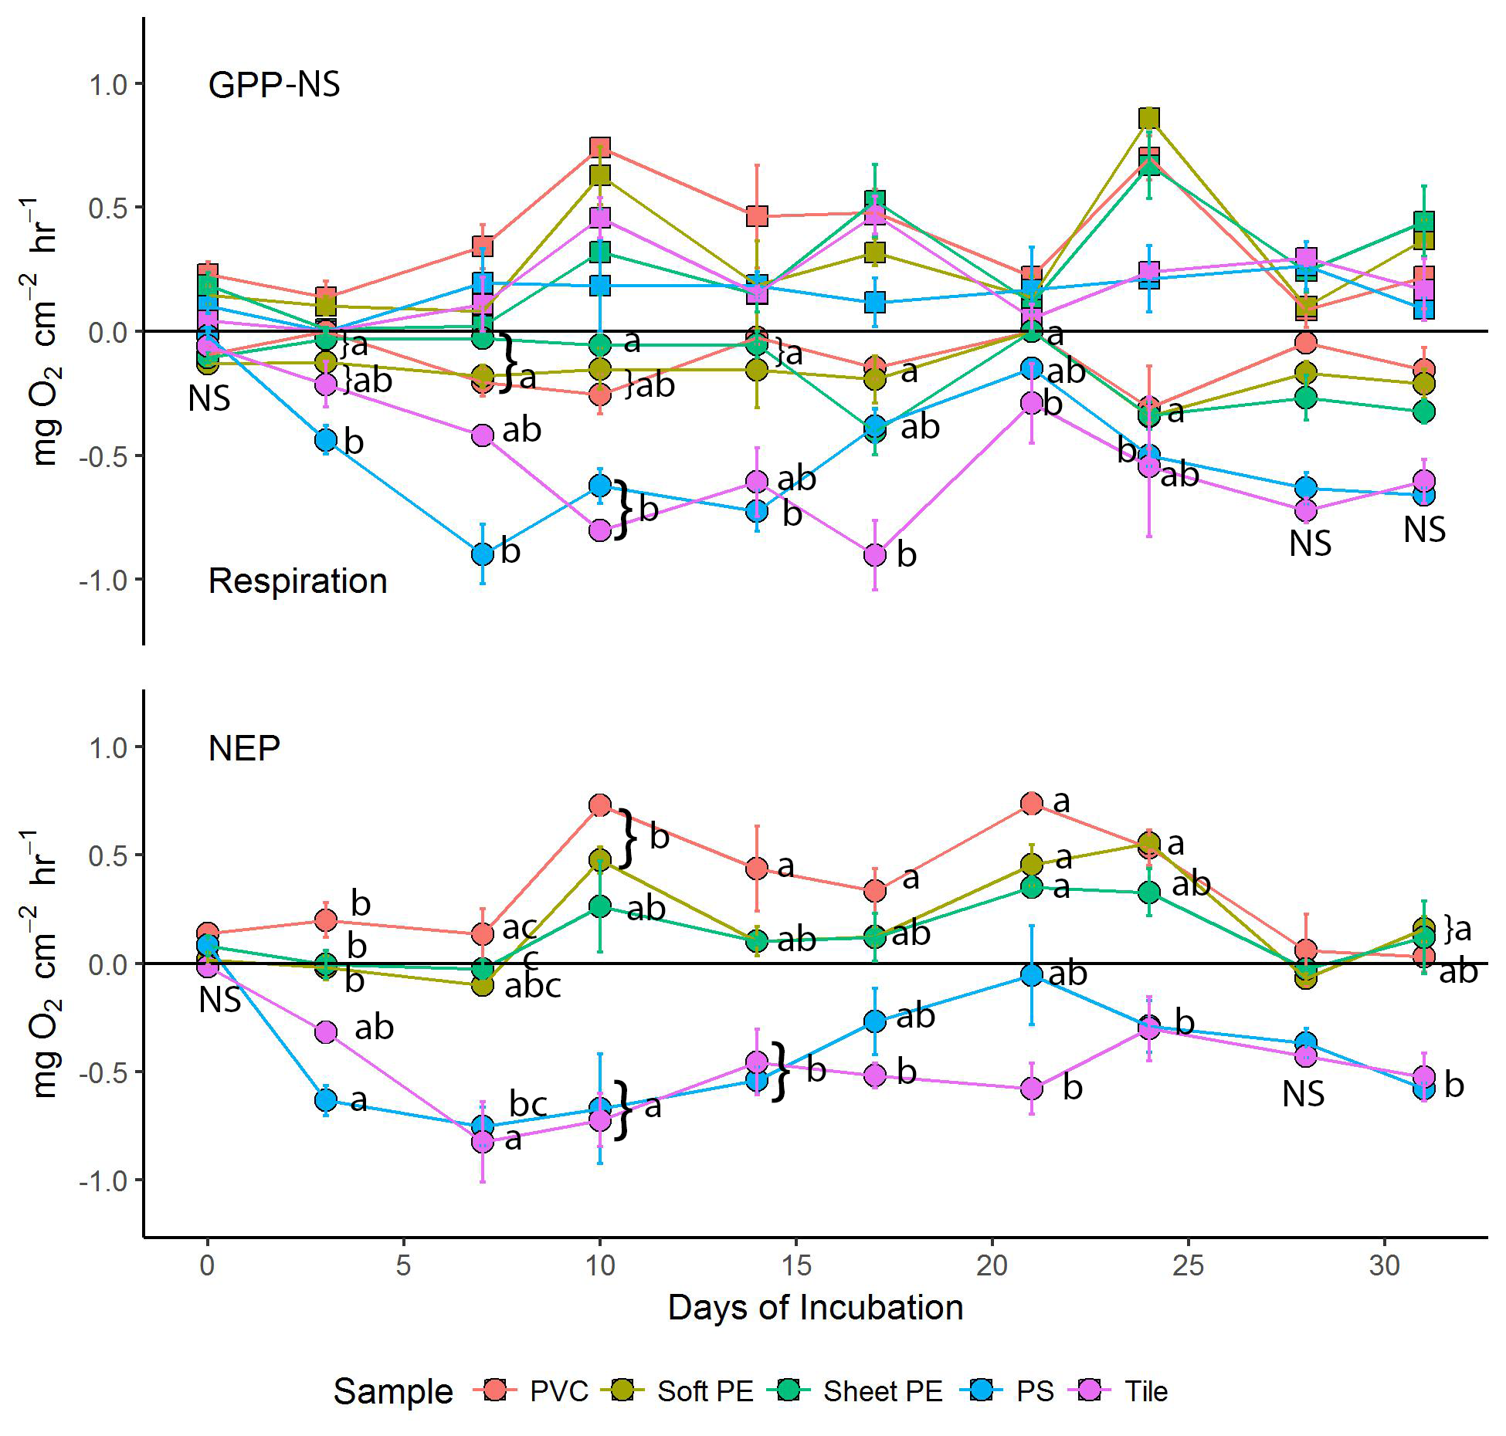
Figure 1. Gross metabolic assays on developing biofilms. Letters are tukey contrasts from one-way ANOVAs within each sampling date. PS (polystyrene) and Tile seem to track together for respiration and consistently had more heterotrophic activity than the other materials. Many of the plastics sampled had net positive NEP whereas the natural analogue, tile, had negative NEP. This represents a major shift in ecosystem function when plastic substrates are present.

Slide 12
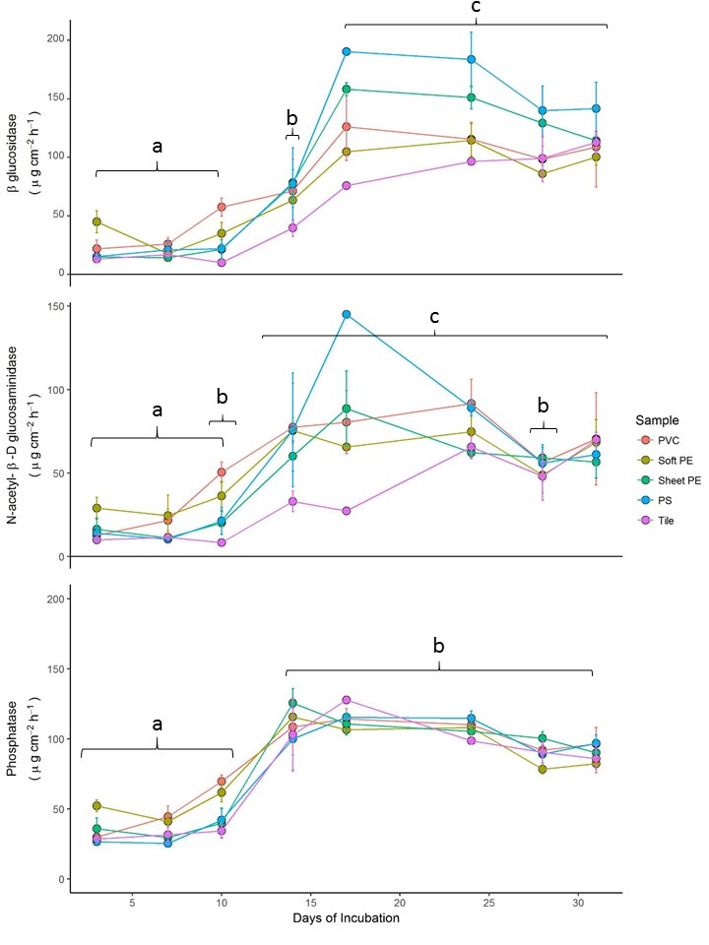
Figure 2. Enzymatic activity potential in river biofilms increases markedly between day 10 and 15. We did not observe any effect of substrate type on enzyme activity potential for NAG and P, but we did for BG. However, when one-way ANOVAs were performed by date and the p-values were corrected there were no longer significant differences between substrates. Tukey contrasts with brackets are between dates.

Slide 13
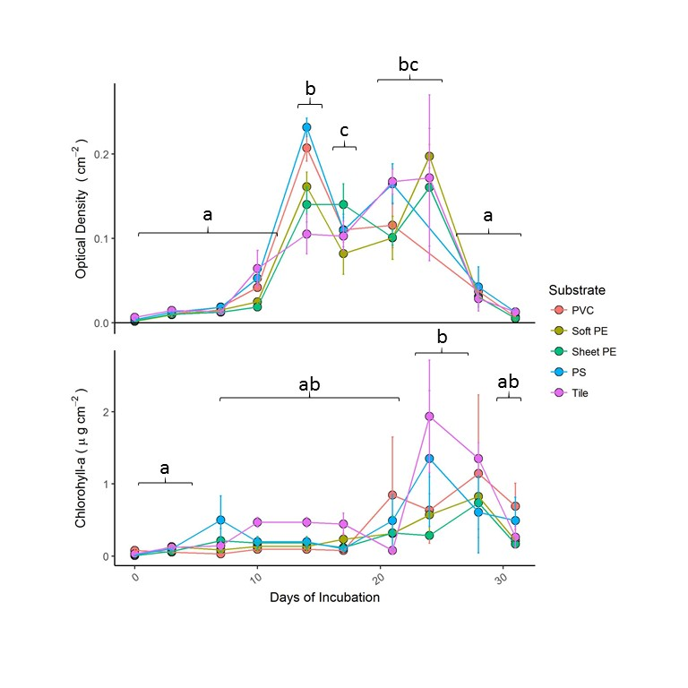
Figure 3. Crystal violet stain (biofilm size) and chlorophyll-a abundance display different temporal patterns. Tukey contrasts with letters are between dates. There was a significant effect of substrate for CV within the LME model, however, when one-way ANOVAs were performed by date and the p-values were corrected there were no longer significant differences between substrates. CV (biofilm size) shows a clear acceleration between 10 and 15 days (same with enzymes!). Chlorophyll concentration remained low for the majority of the incubation and only rose after day 20. This may be due to the canopy opening during litterfall.

Slide 14
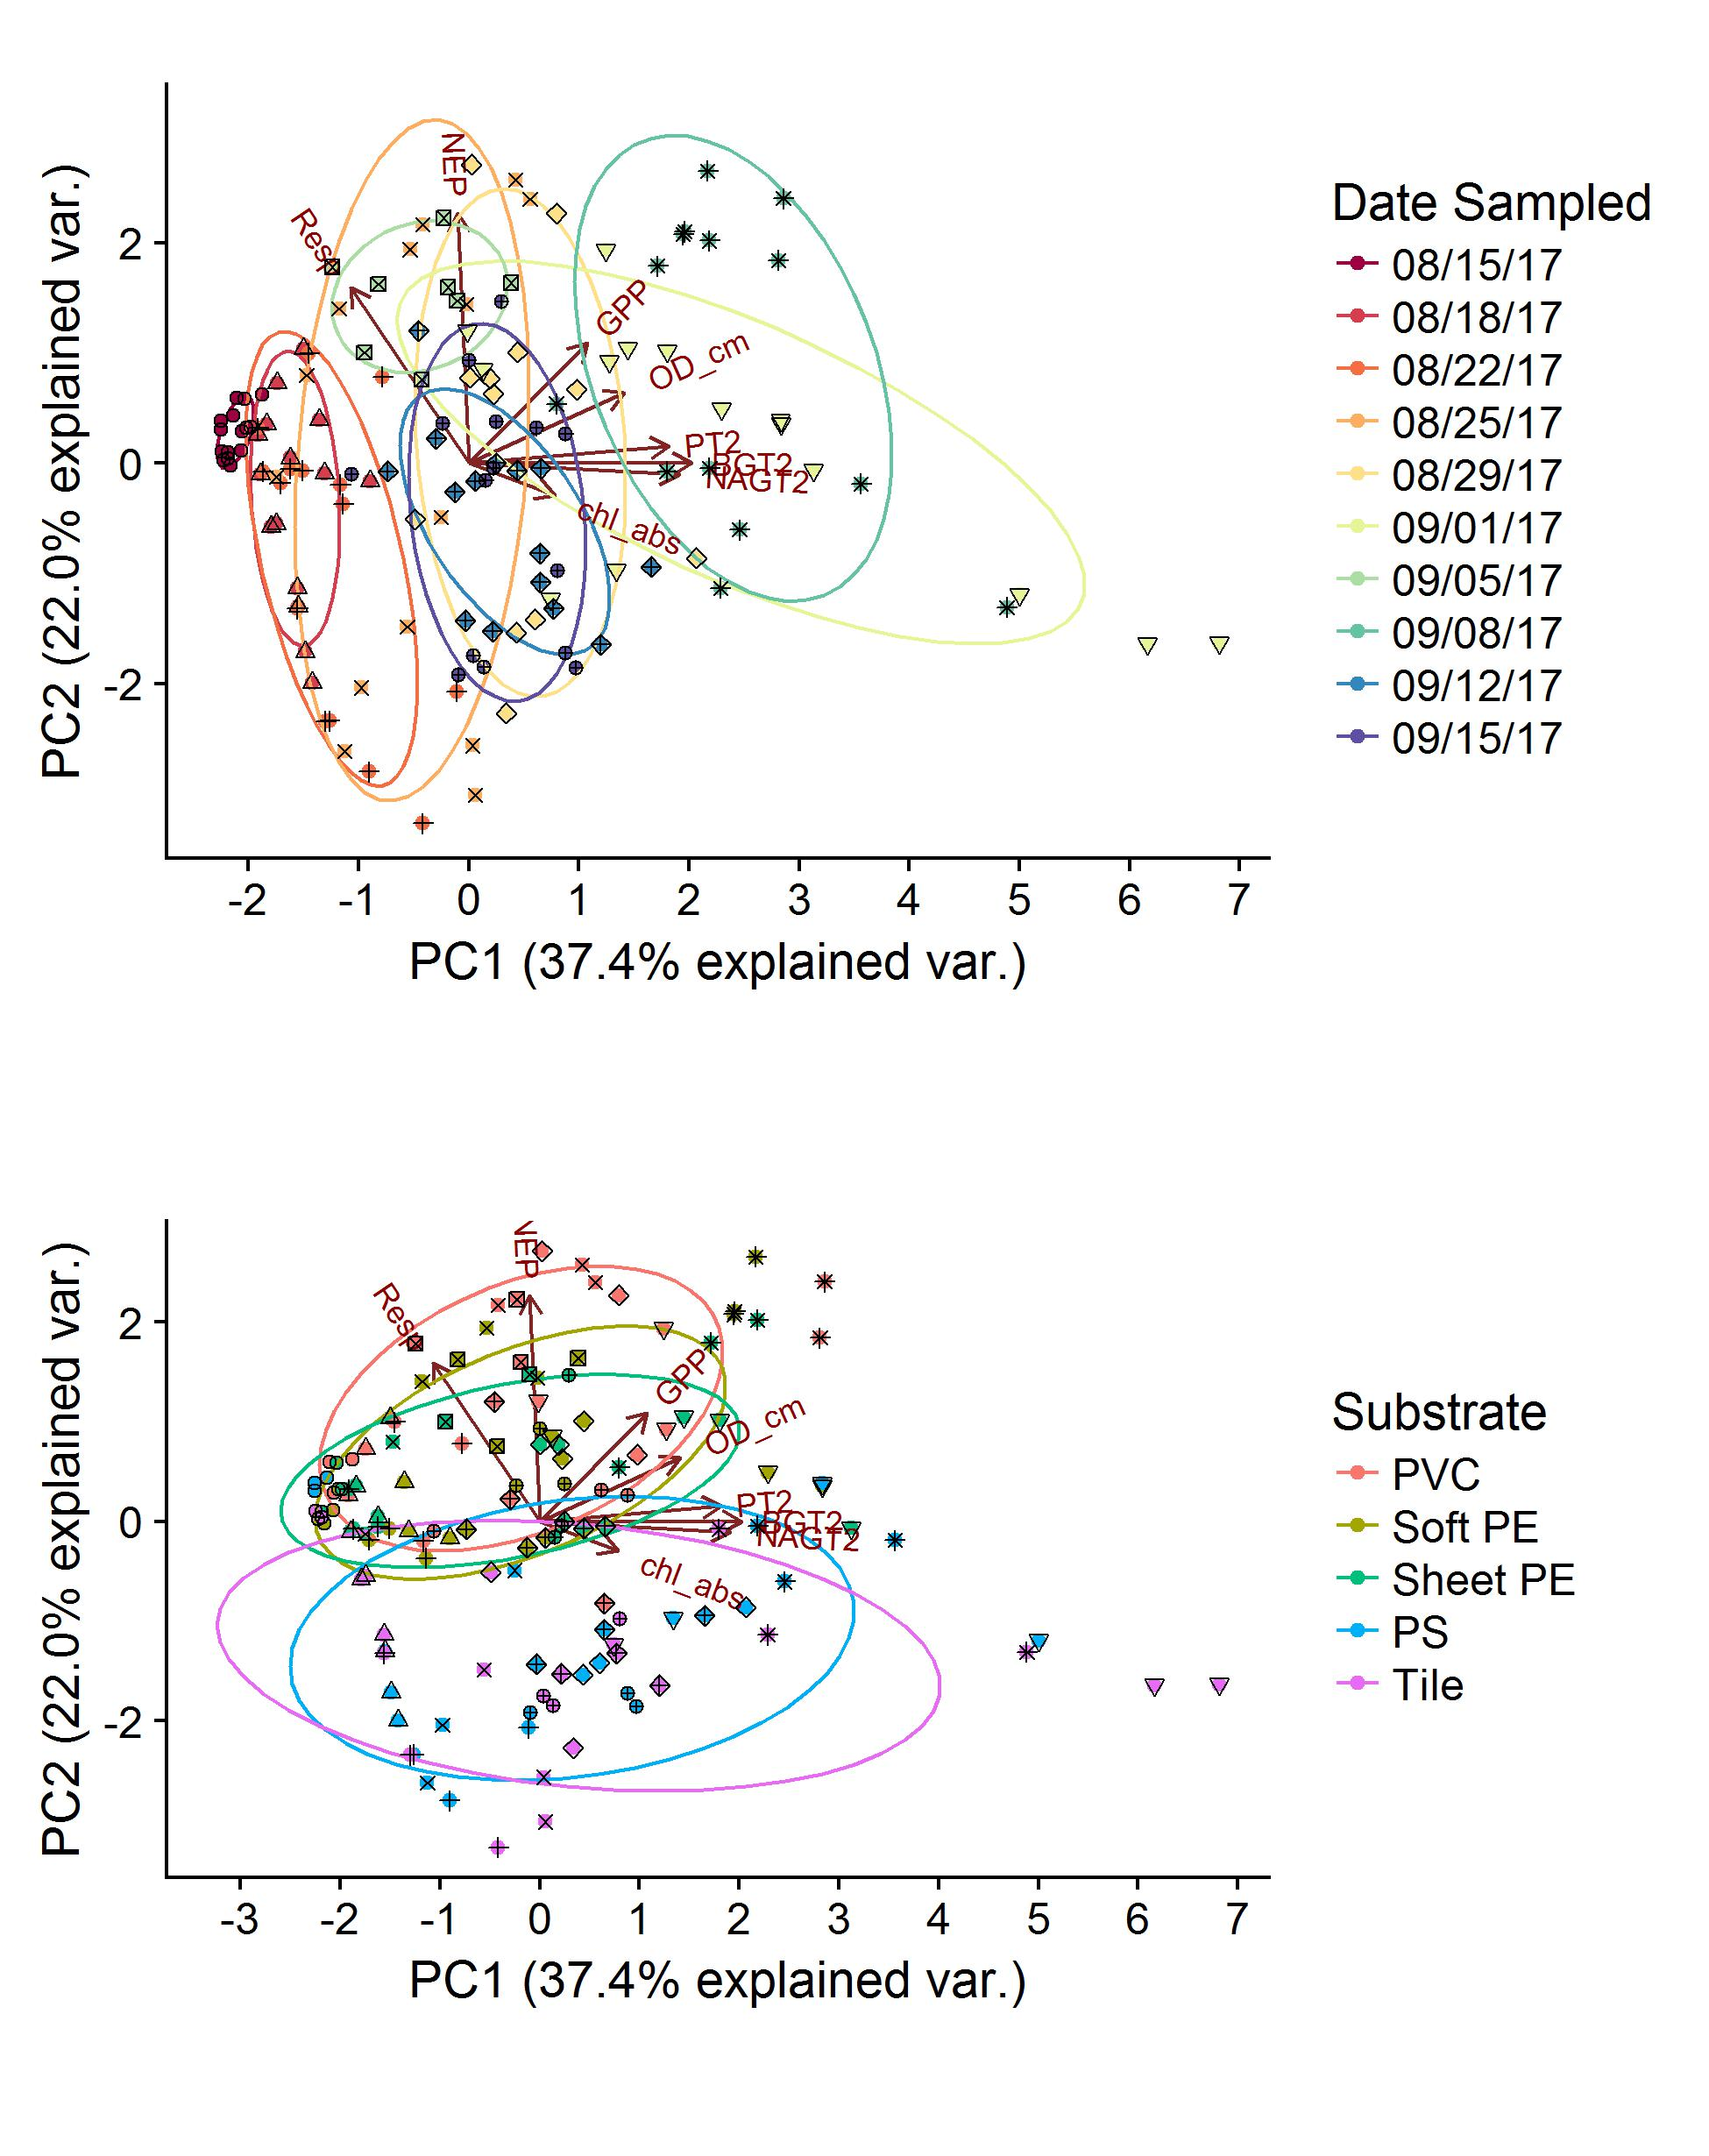
Figure 4. Principal component biplots with groupings for date (top panel) and substrate type (bottom panel). In the top panel, the longest ellipse (09/01.17) stands out as it followed a major discharge pulse. In the bottom panel, tile and Styrofoam clearly differentiate from all materials along PC2.

